Slide 1
Chapter 5 Repetition Structures: Looping

Slide 2
5.1 An Introduction to Repetition Structures: Computers Never Get Bored!
A loop is a block of code that, under certain conditions, will be executed repeatedly.
Declare Number As Integer
Repeat
Write “Please enter a number: “
Input Number
Write Number
Until Number == 0
Write “List Ended”
The body of the loop is executed repeatedly until the user enters a 0. At that point the loop is exited, and the statement that follows the loop is executed.
Note the indentation.

Slide 3
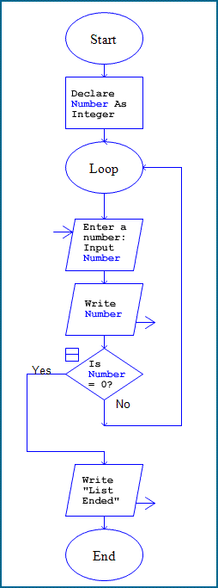
Flowchart:

Slide 4
Iterations
Declare Name As String
Repeat
Write “Enter the name of your
brother or sister: “
Input Name
Write Name
Until Name == “Done”
How many times will the loop run? Each time the loop runs it is called an iteration.
Jim has 2 brothers & 1 sister: 4 iterations
Marie has 1 sister: 2 iterations
Can we create a loop that doesn’t use the test condition as one of the iterations? Yes … we’ll see how later.

Slide 5
Beware the Infinite Loop
The following loop will repeat continually. Can you see why?
Declare ComputerNumber As Integer
Declare Number As Integer
Repeat
Write “Please enter a number: “
Input Number
Set ComputerNumber = Number + 1
Write Number
Until Number > ComputerNumber
Write “The End”
This is called an infinite loop.

Slide 6
Don’t Let the User Get Trapped in the Loop
Be sure to tell the user how to leave the loop.
Example: Add a line, as shown, so the user knows how to stop entering numbers!
Repeat Write “Enter a number”
Write “Enter 0 to end the program”
Input Number Write Number Until Number == 0 Write “Done”

Slide 7
Review: Comparison and Assignment Operators
As an assignment operator, the equals sign sets the value of an expression on the right side to the variable on the left side.
As a comparison operator, the double equals sign asks the question, “Is the value of the variable on the left side the same as the value of the expression, number, or variable on the right side?”
a single equals sign (=) signifies the assignment operator
a double equals sign (==) signifies the comparison operator

Slide 8
Review: Relational and Logical Operators and Compound Conditions
Relational operators are the symbols used in the condition to be evaluated:
= = is the same as (the comparison operator)
!= is not the same as (not equal to)
< less than
> greater than
<= less than or equal to
>= greater than or equal to
Logical operators are used to connect simple conditions into a more complex condition called a compound condition.
The simple conditions each contain one relational operator.

Slide 9
Review: AND, OR, and NOT Logical Operators
A compound condition joined by AND is true only if both simple conditions are true. It is false otherwise.
If (X > 5) AND (X < 10) Then...
is true if X is 6, 7, 8, or 9, both greater than 5 and less than 10.
A compound condition joined by an OR is true if one of the simple conditions is true. It is false only if both are false.
If (Response =“Y”) OR (Response =“y”) Then...
is true if Response is uppercase (“Y”) or lower case (“y”).
NOT affects only one condition. A condition with the NOT operator is true only if the condition is false.
(X > 100) AND NOT(X == Y)
is true only if X is greater than 100 but not equal to the value of Y.

Slide 10
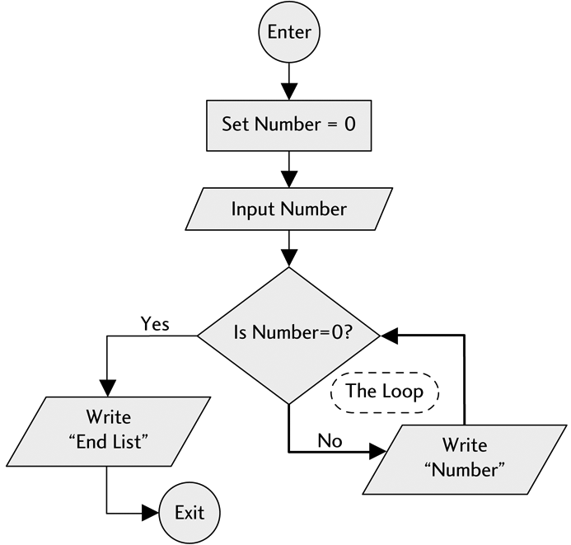
Flowchart for a Simple Repetition Structure (a Loop):

Slide 11
5.2 Types of Loops
Loops are one of the most indispensable tools of any programmer.
Loops are used to load data, manipulate data, interact with the user, and much more.
Loops come in various types. One type may work well for one specific program’s need while another type fits a different program design.
A programmer needs to understand be able to use the different types of loops.
Loops can be divided into two fundamental types: pre-test loops and post-test loops.

Slide 12
post-test loops The test condition occurs after the body of the loop is executed.
Repeat Write “Enter a number: “ Input Number Write Number Until Number == 0 Write “Done” | Do Write “Enter a number: “ Input Number Write Number While Number != 0 Write “Done”
pre-test loops The test condition appears at the top, before the body of the loop is executed the first time.
Write “Enter a number: “ Input Number While Number != 0 Write Number Input Number End While Write “Done”

Slide 13
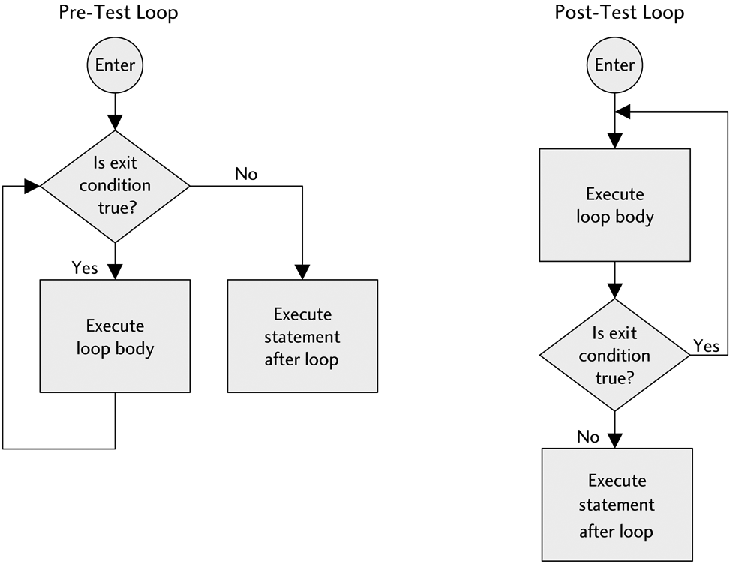
Flowcharts for Pre-test and Post-Test Loops

Slide 14
Trace a Loop: Walk through the loop manually
It is very hard to see what a loop is doing without tracing it to see how it works.
Suppose the user enters: 3, 1, -1.
Trace the code with this input.
Declare Number As Integer
Write “Enter a number or 0 to quit:”
Input Number
While Number > 0
Write Number^2
Input Number
End While
Number Output
3 ___
1 ___
-1 ___

Slide 15
Using a Pre-test Loop Wisely
Previously the program to list the brothers and sisters of a user always ended with the output “Done” (i.e, the test condition).
A pre-test loop can be used to avoid having unwanted data:
Declare Name As String
Write “Enter the name of your brother or sister: “
Input Name
While Name != “Done”
Write Name
Write “Enter the name of your brother or sister: “
Input Name
End While

Slide 16
Counter-controlled Loops
Define a counter: the counter is a variable.
It is always an integer
Common variable names are: counter, Count, I, or j.
Initialize the counter: set the counter to a beginning value.
To count by ones, the computer takes what it had before and adds one.
The code for a computer to count by ones looks like:
Count + 1
Store the new value: store it where the old value was.
If we are counting up by ones, we store the new value by the statement:
Count = Count + 1

Slide 17
Example: Use a Counter to Display the Squares of Numbers
Declare PositiveInteger As Integer
Declare Count As Integer
Write “Please enter a positive integer:“
Input PositiveInteger
Set Count = 1
While Count <= PositiveInteger
Write Count + “ “ + Count^2
Set Count = Count + 1
End While
Output if the user enters 5 for PositiveInteger:
Count Output
1 1 1
2 __ __
3 __ __
4 __ __
5 __ __

Slide 18
Counters Count Up and Down
Here is an example of using a counter in a loop to count down.
Countdown to Blastoff:
Declare Count As Integer
Set Count = 100
Write “Countdown in ...”
While Count > 0
Write Count + “ seconds”
Set Count = Count – 1
End While

Slide 19
5.3 The For Loop
Most languages have a shortened method, called a For loop, to initialize the counter; increase or decrease the counter; and to tell the computer when to stop.
We use the following pseudocode in our For loop:
For (Counter = InitialValue; TestCondition; Counter++)
body of the loop
End For
Counter equals the specified InitialValue
Counter increments by 1 (in this example) on each pass through the loop.
Counter++ acts just like the statement Counter = Counter + 1
This continues until the TestCondition is met

Slide 20
The Initial Value in a For Loop
The initial value can be:
any integer constant, such as 1, 0, 23, or –4
another numeric variable
set equal to an expression containing a numeric variable and a number
such as Count = (LowNumber + 3)
The counter itself must be a variable and the initial value must be an integer.
Examples:
Count = 5 is valid
Count = NewNumber is valid if NewNumber is an integer variable
Count = (NewNumber * 2) is valid
Count = (5/2) is not valid because 5/2 is not an integer
23 = Count is not valid

Slide 21
The Test Condition in a For Loop
The test condition asks, “Is the counter within the range specified by this condition?”
If the test condition is Count < 10:
If the answer is “yes” then the loop executes again.
If the answer is “no” then the loop is exited.
When Count is equal to 10, the loop will be exited.
However, if the test condition is Count <=10:
The question is, “Is the value of Count less than or equal to 10?”
The loop will not be exited until Count is at least 11.
The test condition is checked at the end of a loop in a post-test loop and at the beginning in a pre-test loop.
In a For loop, the test condition is checked at the beginning. If the initial value of the counter passes the test condition, the loop is entered once. After the loop body executes once, the counter is then either incremented or decremented and the test condition is checked again.

Slide 22
More About the Test Condition
The test condition can also be a number, another variable with a numeric value, or an expression containing variables and numbers. For example:
Count < 5
is valid and will execute until Count has the value of 5 or more
Count >= 6
is valid and will execute until Count becomes 5 or less
Count >= NewNumber
is valid and will execute until Count becomes less than the value of NewNumber
Count < (NewNumber + 5)
is valid and will execute until Count becomes greater than or equal to the value of NewNumber + 5

Slide 23
The Increment/Decrement Statement
The Increment or Decrement statement is like:
Count = Count + 1 or Count = Count – 1
Many programming languages use a shorthand method. We will use:
Count++ increments the variable named Count by 1 (i.e., counts up)
Count–– decrements the variable named Count by 1 (i.e., counts down)
To increase or decrease a counter by any integer other than 1, we will use the shorthand:
Count+2 increments Count by 2
This shorthand is comparable to Count = Count + 2
Count–3 decrements Count by 3
This shorthand is comparable to Count = Count – 3
Count+X will increase Count by the value of X
Count–X will decrease Count by the value of X

Slide 24
Examples
Results:
1. 2.
0 15
5 10
10 5
15 0
3. 4.
1 1
4 3
7 5
7
9
11
13
1. For (Count = 0; Count <= 15; Count+5)
Write Count
End For
2. For (Count = 15; Count >= 0; Count–5)
Write Count
End For
3. Set MyNumber = 7
For (Count = 1; Count <= (MyNumber + 1); Count+3)
Write Count
End For
4. For (Count = 1; Count < 15; Count+2)
Write Count
End For

Slide 25
The Prisoner in the Loop
If the loop increment is positive and the initial value is greater than the limiting value, then the body of the loop is skipped as follows:
Write “Hello”
Declare Count As Integer
For (Count = 5; Count < 4; Count++)
Write “Help, I’m a prisoner in a For loop!”
End For
Write “Goodbye”

Slide 26
5.4 Applications of Repetition Structures
Loops have many purposes. This section will cover a few:
Use to input data
Data validation
Using the Int() or Floor() and Ceiling() functions
Computing sums and averages

Slide 27
Sentinel Controlled Loops
Loops are often used to input large amounts of data.
On each pass through the loop, one item of data (or one set of data) is entered.
The test condition must cause the loop to be exited after all data has been input.
Often the way to force a loop to end is to have the user enter a sentinel value to signal that input is complete.
The sentinel item (or end-of-data marker) should be chosen so that it cannot possibly be mistaken for actual input data.
A sentinel-controlled loop uses a sentinel value to determine whether or not the loop is to be exited.

Slide 28
Sentinel Controlled Loop Example
Declare Hours, Rate, Salary As Float
Write “Enter the number of hours this employee worked: “
Write “Enter –1 when you are done.”
Input Hours
While Hours != –1
Write “Enter this employee’s rate of pay: “
Input Rate
Set Salary = Hours * Rate
Write “An employee who worked “ + Hours
Write “at the rate of “ + Rate + “ per hour”
Write “receives a salary of $ “ + Salary
Write “Enter the number of hours this employee worked: “
Write “Enter –1 when you are done.”
Input Hours
End While

Slide 29
Data Validation: Loops are often used to validate data entered by a user.
Example: to ensure that a user enters a positive number:
Declare WidgetsOrdered As Integer
Write “How many widgets do you want to order? “
Input WidgetsOrdered
While WidgetsOrdered < 0
Write “You can’t order a negative number of widgets.”
Write “Please enter a positive number or zero: “
Input WidgetsOrdered
End While

Slide 30
The Int() Function
The Int() function takes any number and turns it into an integer. It is often used to ensure that data is an integer.
Examples:
Int(53) = 53 → the integer value of an integer is just that integer.
Int(53.195) = 53 → the integer value of a floating point number is just the integer part, with the fractional part discarded.
Int(53.987) = 53 → note that since the fractional part is discarded, 53.0001 is the same, after implementing the Int() function, as 53.9999.
Given: Number1 = 15.25 and Number2 = –4.5, then:
Int(Number1) = 15 → Number1 represents 15.25, Int() function turns the value of Number1 into its integer part.
Int(Number2) = –4 → Number2 represents –4.5 and the integer part of this is –4.
Int(4*2.4) = 9 → first the Int() function does the math inside the parentheses and then returns the value as an integer.

Slide 31
Using the Int() Function for Data Validation
Declare MySquare As Integer
Declare Count As Integer
Repeat
Write “Enter an integer: “
Input MySquare
Until Int(MySquare) == MySquare
For (Count = 1; Count <= MySquare; Count++)
Write Count + “ “ + Count^2
End For
This program segment first validates the input to make sure it is an integer. Note how it uses the Int() function and a loop to do this. Once the valid input has been entered, a For loop is used to display the squares of the numbers from 1 up to and including the number input.

Slide 32
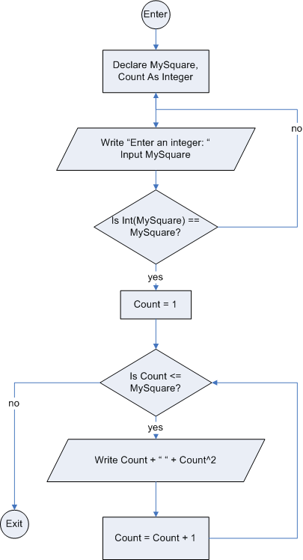
Flowchart for using
the Int() function
for data validation

Slide 33
The Floor() and Ceiling() Functions
Floor() takes any number and discards the decimal part (i.e., it “rounds down”)
Ceiling() takes any number and “rounds up” to the next integer
Like Int(), Floor() and Ceiling() accept numbers, variables, and expressions
Examples:
Floor(62) = 62 Ceiling(62) = 62
Floor(62.34) = 62 Ceiling(62.34) = 63
Given: NumberOne = 12.2 and NumberTwo = 3.8
Floor(NumberOne) = 12 Ceiling(NumberOne) = 13
Floor(NumberTwo) = 3 Ceiling(NumberTwo) = 4
Floor(NumberOne * 4) = 48 Ceiling(NumberOne * 4) = 49
If Number = 7.83, the following statements are valid:
Write Floor(Number) displays 7
Write Ceiling(Number) displays 8
Set Y = Floor(Number) assigns the value of 7 to Y
Set Y = Ceiling(Number) assigns the value of 8 to Y
Set X = Floor(Number/2) assigns the value of 3 to X
Set X = Ceiling(Number/2) assigns the value of 4 to X

Slide 34
Using a Loop to Compute a Sum
Note: the variable Sum is known as the accumulator because it accumulates the values of the inputs.
Example:
1 Declare Sum, Number As Integer
2 Set Sum = 0
3 Write “Enter a positive whole number or 0 when done.”
4 Input Number
5 While Number > 0
6 Set Sum = Sum + Number
7 Write “Enter a positive whole number or 0 when done.”
9 Input Number
9 End While
10 Write “The sum of the numbers input is “ + Sum

Slide 35
Computing Averages
Example:
1 Declare CountGrades As Integer
2 Declare SumGrades, Grade, ExamAverage As Float
3 Set CountGrades = 0
4 Set SumGrades = 0
5 Write “Enter one exam grade. Enter 0 when done.”
6 Input Grade
7 While Grade > 0
8 Set CountGrades = CountGrades + 1
9 Set SumGrades = SumGrades + Grade
10 Write “Enter an exam grade. Enter 0 when done.”
11 Input Grade
12 End While
13 Set ExamAverage = SumGrades/CountGrades
14 Write “Your exam average is “ + ExamAverage

